Slide 1
SIA RECAP

Slide 2
Software products
Generic products
Stand-alone systems that are marketed and sold to any customer who wishes to buy them.
Examples – PC software such as graphics programs, project management tools; CAD software; software for specific markets such as appointments systems for dentists.
Customized products
Software that is commissioned by a specific customer to meet their own needs.
Examples – embedded control systems, air traffic control software, traffic monitoring systems.

Slide 3
Software engineering
Software engineering is an engineering discipline that is concerned with all aspects of software production from the early stages of system specification through to maintaining the system after it has gone into use.
Engineering discipline
Using appropriate theories and methods to solve problems bearing in mind organizational and financial constraints.
All aspects of software production
Not just technical process of development. Also project management and the development of tools, methods etc. to support software production.

Slide 4
Importance of software engineering
More and more, individuals and society rely on advanced software systems. We need to be able to produce reliable and trustworthy systems economically and quickly.
It is usually cheaper, in the long run, to use software engineering methods and techniques for software systems rather than just write the programs as if it was a personal programming project. For most types of system, the majority of costs are the costs of changing the software after it has gone into use.

Slide 5
Software process activities
Software specification, where customers and engineers define the software that is to be produced and the constraints on its operation.
Software development, where the software is designed and programmed.
Software validation, where the software is checked to ensure that it is what the customer requires.
Software evolution, where the software is modified to reflect changing customer and market requirements.

Slide 6
Application types
Stand-alone applications
These are application systems that run on a local computer, such as a PC. They include all necessary functionality and do not need to be connected to a network.
Interactive transaction-based applications
Applications that execute on a remote computer and are accessed by users from their own PCs or terminals. These include web applications such as e-commerce applications.
Embedded control systems
These are software control systems that control and manage hardware devices. Numerically, there are probably more embedded systems than any other type of system.

Slide 7
Application types
Batch processing systems
These are business systems that are designed to process data in large batches. They process large numbers of individual inputs to create corresponding outputs.
Entertainment systems
These are systems that are primarily for personal use and which are intended to entertain the user.
Systems for modeling and simulation
These are systems that are developed by scientists and engineers to model physical processes or situations, which include many, separate, interacting objects.

Slide 8
Application types
Data collection systems
These are systems that collect data from their environment using a set of sensors and send that data to other systems for processing.
Systems of systems
These are systems that are composed of a number of other software systems.

Slide 9
Software Processes

Slide 10
Plan-driven and agile processes
Plan-driven processes are processes where all of the process activities are planned in advance and progress is measured against this plan.
In agile processes, planning is incremental and it is easier to change the process to reflect changing customer requirements.
In practice, most practical processes include elements of both plan-driven and agile approaches.
There are no right or wrong software processes.

Slide 11
Software process models
The waterfall model
Plan-driven model. Separate and distinct phases of specification and development.
Incremental development
Specification, development and validation are interleaved. May be plan-driven or agile.
Reuse-oriented software engineering
The system is assembled from existing components. May be plan-driven or agile.
In practice, most large systems are developed using a process that incorporates elements from all of these models.

Slide 12
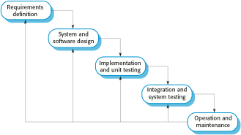
The waterfall model

Slide 13
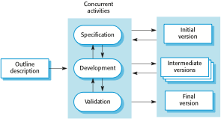
Incremental development

Slide 14

Reuse-oriented software engineering

Slide 15
Types of software component
Web services that are developed according to service standards and which are available for remote invocation.
Collections of objects that are developed as a package to be integrated with a component framework such as .NET or J2EE.
Stand-alone software systems (COTS) that are configured for use in a particular environment.

Slide 16
Agile Software Development

Slide 17
Agile methods
Dissatisfaction with the overheads involved in software design methods of the 1980s and 1990s led to the creation of agile methods. These methods:
Focus on the code rather than the design
Are based on an iterative approach to software development
Are intended to deliver working software quickly and evolve this quickly to meet changing requirements.
The aim of agile methods is to reduce overheads in the software process (e.g. by limiting documentation) and to be able to respond quickly to changing requirements without excessive rework.

Slide 18
Extreme programming
Perhaps the best-known and most widely used agile method.
Extreme Programming (XP) takes an ‘extreme’ approach to iterative development.
New versions may be built several times per day;
Increments are delivered to customers every 2 weeks;
All tests must be run for every build and the build is only accepted if tests run successfully.

Slide 19
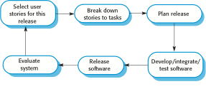
The extreme programming release cycle

Slide 20
Extreme programming practices (a)
Principle or practice | Description
Incremental planning | Requirements are recorded on story cards and the stories to be included in a release are determined by the time available and their relative priority. The developers break these stories into development ‘Tasks’.
Small releases | The minimal useful set of functionality that provides business value is developed first. Releases of the system are frequent and incrementally add functionality to the first release.
Simple design | Enough design is carried out to meet the current requirements and no more.
Test-first development | An automated unit test framework is used to write tests for a new piece of functionality before that functionality itself is implemented.
Refactoring | All developers are expected to refactor the code continuously as soon as possible code improvements are found. This keeps the code simple and maintainable.

Slide 21
Extreme programming practices (b)
Pair programming | Developers work in pairs, checking each other’s work and providing the support to always do a good job.
Collective ownership | The pairs of developers work on all areas of the system, so that no islands of expertise develop and all the developers take responsibility for all of the code. Anyone can change anything.
Continuous integration | As soon as the work on a task is complete, it is integrated into the whole system. After any such integration, all the unit tests in the system must pass.
Sustainable pace | Large amounts of overtime are not considered acceptable as the net effect is often to reduce code quality and medium term productivity
On-site customer | A representative of the end-user of the system (the customer) should be available full time for the use of the XP team. In an extreme programming process, the customer is a member of the development team and is responsible for bringing system requirements to the team for implementation.

Slide 22
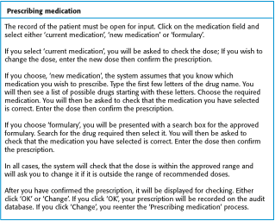
A ‘prescribing medication’ story

Slide 23
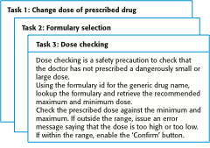
Examples of task cards for prescribing medication

Slide 24
Testing in XP
Testing is central to XP and XP has developed an approach where the program is tested after every change has been made.
XP testing features:
Test-first development.
Incremental test development from scenarios.
User involvement in test development and validation.
Automated test harnesses are used to run all component tests each time that a new release is built.

Slide 25
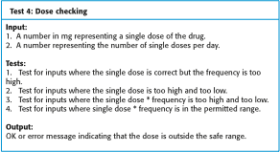
Test case description for dose checking

Slide 26
Test automation
Test automation means that tests are written as executable components before the task is implemented
These testing components should be stand-alone, should simulate the submission of input to be tested and should check that the result meets the output specification. An automated test framework (e.g. Junit) is a system that makes it easy to write executable tests and submit a set of tests for execution.
As testing is automated, there is always a set of tests that can be quickly and easily executed
Whenever any functionality is added to the system, the tests can be run and problems that the new code has introduced can be caught immediately.

Slide 27
Scrum
The Scrum approach is a general agile method but its focus is on managing iterative development rather than specific agile practices.
There are three phases in Scrum.
The initial phase is an outline planning phase where you establish the general objectives for the project and design the software architecture.
This is followed by a series of sprint cycles, where each cycle develops an increment of the system.
The project closure phase wraps up the project, completes required documentation such as system help frames and user manuals and assesses the lessons learned from the project.

Slide 28
Requirements Engineering

Slide 29
Requirements engineering
The process of establishing the services that the customer requires from a system and the constraints under which it operates and is developed.
The requirements themselves are the descriptions of the system services and constraints that are generated during the requirements engineering process.

Slide 30
What is a requirement?
A requirement is a high-level abstract statement of a service or of a system constraint.
This is inevitable as requirements may serve a dual function
May be the basis for a bid for a contract - therefore must be open to interpretation;
May be the basis for the contract itself - therefore must be defined in detail;
Both these statements may be called requirements.

Slide 31
Types of requirement
User requirements
Statements in natural language plus diagrams of the services the system provides and its operational constraints. Written for customers.
System requirements
A structured document setting out detailed descriptions of the system’s functions, services and operational constraints. Defines what should be implemented so may be part of a contract between client and contractor.

Slide 32
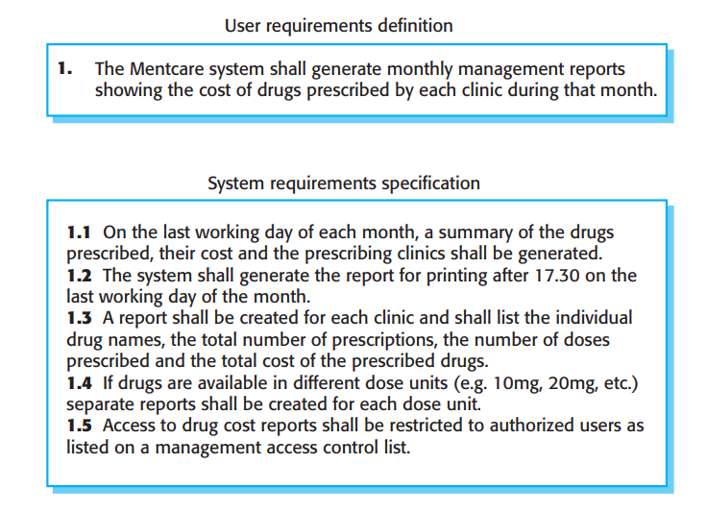
User and system requirements

Slide 33
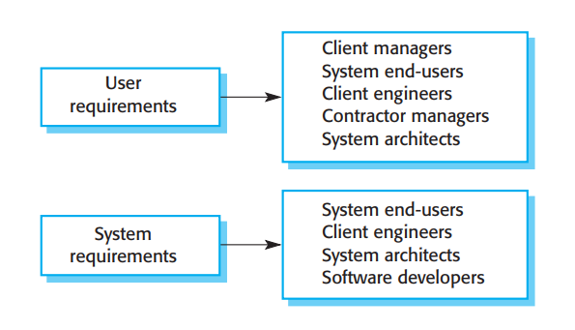
Readers of different types of requirements specification

Slide 34
Functional and non-functional requirements
Functional requirements
Statements of services the system should provide, how the system should react to particular inputs and how the system should behave in particular situations.
May state what the system should not do.
Non-functional requirements
Constraints on the services or functions offered by the system such as timing constraints, constraints on the development process, standards, etc.
Often apply to the system as a whole rather than individual features or services.
Domain requirements
Constraints on the system from the domain of operation

Slide 35
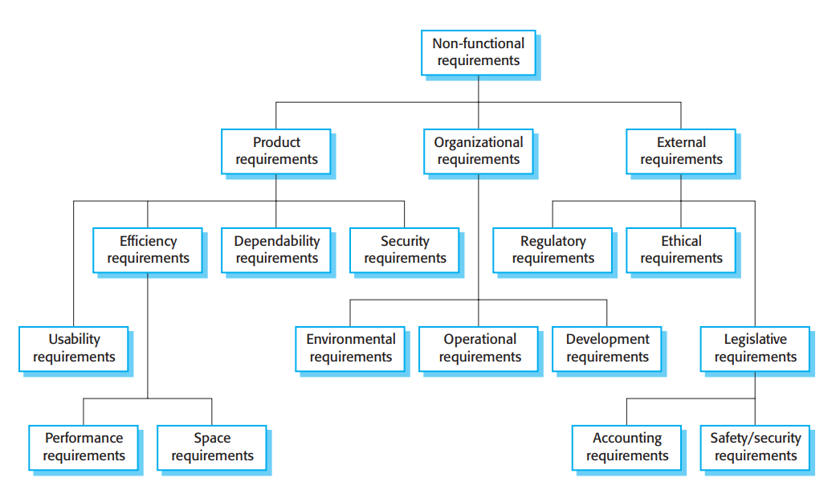
Types of nonfunctional requirement

Slide 36
Metrics for specifying nonfunctional requirements
Property | Measure
Speed | Processed transactions/second User/event response time Screen refresh time
Size | Mbytes Number of ROM chips
Ease of use | Training time Number of help frames
Reliability | Mean time to failure Probability of unavailability Rate of failure occurrence Availability
Robustness | Time to restart after failure Percentage of events causing failure Probability of data corruption on failure
Portability | Percentage of target dependent statements Number of target systems

Slide 37
Requirements engineering processes
The processes used for RE vary widely depending on the application domain, the people involved and the organisation developing the requirements.
However, there are a number of generic activities common to all processes
Requirements elicitation;
Requirements analysis;
Requirements validation;
Requirements management.
In practice, RE is an iterative activity in which these processes are interleaved.

Slide 38
Requirements elicitation and analysis
Sometimes called requirements elicitation or requirements discovery.
Involves technical staff working with customers to find out about the application domain, the services that the system should provide and the system’s operational constraints.
May involve end-users, managers, engineers involved in maintenance, domain experts, trade unions, etc. These are called stakeholders.

Slide 39
Process activities
Requirements discovery
Interacting with stakeholders to discover their requirements. Domain requirements are also discovered at this stage.
Requirements classification and organisation
Groups related requirements and organises them into coherent clusters.
Prioritisation and negotiation
Prioritising requirements and resolving requirements conflicts.
Requirements specification
Requirements are documented and input into the next round of the spiral.

Slide 40
Requirements discovery
The process of gathering information about the required and existing systems and distilling the user and system requirements from this information.
Interaction is with system stakeholders from managers to external regulators.
Systems normally have a range of stakeholders.

Slide 41
Requirement elicitation technique: Interviewing
Formal or informal interviews with stakeholders are part of most RE processes.
Types of interview
Closed interviews based on pre-determined list of questions
Open interviews where various issues are explored with stakeholders.
Effective interviewing
Be open-minded, avoid pre-conceived ideas about the requirements and are willing to listen to stakeholders.
Prompt the interviewee to get discussions going using a springboard question, a requirements proposal, or by working together on a prototype system.

Slide 42
Scenarios
Scenarios are real-life examples of how a system can be used.
They should include
A description of the starting situation;
A description of the normal flow of events;
A description of what can go wrong;
Information about other concurrent activities;
A description of the state when the scenario finishes.

Slide 43
The software requirements document
The software requirements document is the official statement of what is required of the system developers.
Should include both a definition of user requirements and a specification of the system requirements.
It is NOT a design document. As far as possible, it should set of WHAT the system should do rather than HOW it should do it.

Slide 44
Requirements validation
Concerned with demonstrating that the requirements define the system that the customer really wants.
Requirements error costs are high so validation is very important
Fixing a requirements error after delivery may cost up to 100 times the cost of fixing an implementation error.

Slide 45
Requirements management
Requirements management is the process of managing changing requirements during the requirements engineering process and system development.
New requirements emerge as a system is being developed and after it has gone into use.
You need to keep track of individual requirements and maintain links between dependent requirements so that you can assess the impact of requirements changes. You need to establish a formal process for making change proposals and linking these to system requirements.

Slide 46
System Modeling

Slide 47
System modeling
System modeling is the process of developing abstract models of a system, with each model presenting a different view or perspective of that system.
System modeling has now come to mean representing a system using some kind of graphical notation, which is now almost always based on notations in the Unified Modeling Language (UML).
System modelling helps the analyst to understand the functionality of the system and models are used to communicate with customers.

Slide 48
System perspectives
An external perspective, where you model the context or environment of the system.
An interaction perspective, where you model the interactions between a system and its environment, or between the components of a system.
A structural perspective, where you model the organization of a system or the structure of the data that is processed by the system.
A behavioral perspective, where you model the dynamic behavior of the system and how it responds to events.

Slide 49
UML diagram types
Activity diagrams, which show the activities involved in a process or in data processing .
Use case diagrams, which show the interactions between a system and its environment.
Sequence diagrams, which show interactions between actors and the system and between system components.
Class diagrams, which show the object classes in the system and the associations between these classes.
State diagrams, which show how the system reacts to internal and external events.

Slide 50
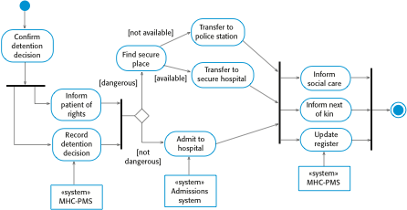
Process model of involuntary detention

Slide 51
Context models
Context models are used to illustrate the operational context of a system - they show what lies outside the system boundaries.
Social and organisational concerns may affect the decision on where to position system boundaries.
Architectural models show the system and its relationship with other systems.

Slide 52
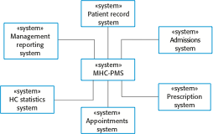
The context of the MHC-PMS

Slide 53
Use case modeling
Use cases were developed originally to support requirements elicitation and now incorporated into the UML.
Each use case represents a discrete task that involves external interaction with a system.
Actors in a use case may be people or other systems.
Represented diagramatically to provide an overview of the use case and in a more detailed textual form.

Slide 54
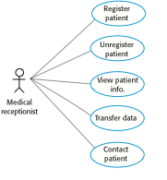
Use cases in the MHC-PMS involving the role ‘Medical Receptionist’

Slide 55
Sequence diagrams
Sequence diagrams are part of the UML and are used to model the interactions between the actors and the objects within a system.
A sequence diagram shows the sequence of interactions that take place during a particular use case or use case instance.
The objects and actors involved are listed along the top of the diagram, with a dotted line drawn vertically from these.
Interactions between objects are indicated by annotated arrows.

Slide 56
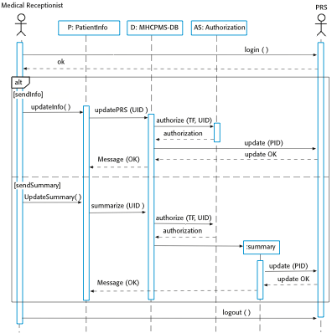
Sequence diagram for Transfer Data

Slide 57
Class diagrams
Class diagrams are used when developing an object-oriented system model to show the classes in a system and the associations between these classes.
An object class can be thought of as a general definition of one kind of system object.
An association is a link between classes that indicates that there is some relationship between these classes.
When you are developing models during the early stages of the software engineering process, objects represent something in the real world, such as a patient, a prescription, doctor, etc.

Slide 58
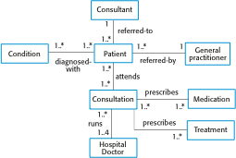
Classes and associations in the MHC-PMS

Slide 59
Classes and associations in the MHC-PMS

Slide 60
State machine models
These model the behaviour of the system in response to external and internal events.
They show the system’s responses to stimuli so are often used for modelling real-time systems.
State machine models show system states as nodes and events as arcs between these nodes. When an event occurs, the system moves from one state to another.
Statecharts are an integral part of the UML and are used to represent state machine models.

Slide 61
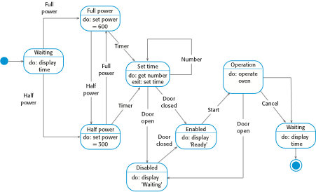
State diagram of a microwave oven

Slide 62
Architectural Design

Slide 63
Software architecture
The design process for identifying the sub-systems making up a system and the framework for sub-system control and communication is architectural design.
The output of this design process is a description of the software architecture.

Slide 64
Box and line diagrams
Very abstract - they do not show the nature of component relationships nor the externally visible properties of the sub-systems.
However, useful for communication with stakeholders and for project planning.

Slide 65
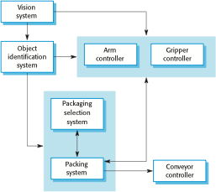
The architecture of a packing robot control system

Slide 66
Architectural patterns
Patterns are a means of representing, sharing and reusing knowledge.
An architectural pattern is a stylized description of good design practice, which has been tried and tested in different environments.
Patterns should include information about when they are and when the are not useful.
Patterns may be represented using tabular and graphical descriptions.

Slide 67
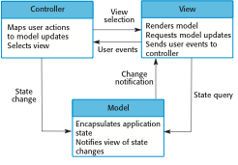
The organization of the Model-View-Controller

Slide 68
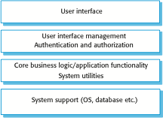
A generic layered architecture

Slide 69
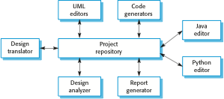
A repository architecture for an IDE

Slide 70
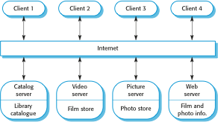
A client–server architecture for a film library

Slide 71
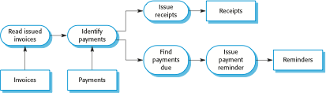
An example of the pipe and filter architecture

Slide 72
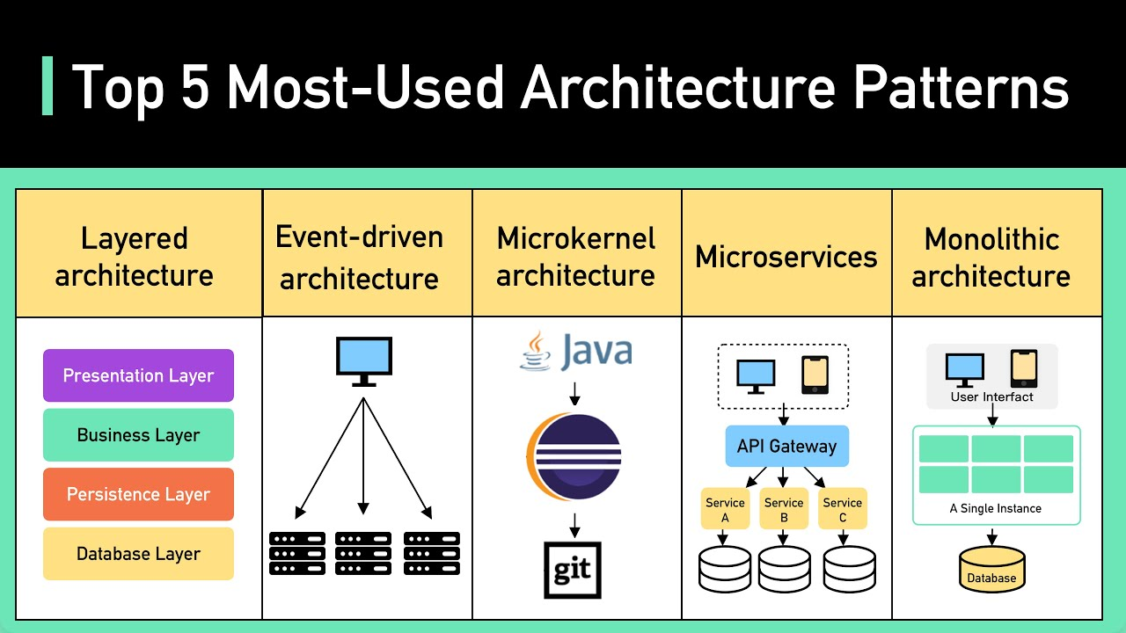
https://www.youtube.com/watch?app=desktop&v=f6zXyq4VPP8

Slide 73
Design and Implementation

Slide 74
Design and implementation
Software design and implementation is the stage in the software engineering process at which an executable software system is developed.
Software design and implementation activities are invariably inter-leaved.
Software design is a creative activity in which you identify software components and their relationships, based on a customer’s requirements.
Implementation is the process of realizing the design as a program.

Slide 75
Build or buy
In a wide range of domains, it is now possible to buy off-the-shelf systems (COTS) that can be adapted and tailored to the users’ requirements.
For example, if you want to implement a medical records system, you can buy a package that is already used in hospitals. It can be cheaper and faster to use this approach rather than developing a system in a conventional programming language.
When you develop an application in this way, the design process becomes concerned with how to use the configuration features of that system to deliver the system requirements.

Slide 76
Process stages
There are a variety of different object-oriented design processes that depend on the organization using the process.
Common activities in these processes include:
Define the context and modes of use of the system;
Design the system architecture;
Identify the principal system objects;
Develop design models;
Specify object interfaces.
Process illustrated here using a design for a wilderness weather station.

Slide 77
Design models
Design models show the objects and object classes and relationships between these entities.
Static models describe the static structure of the system in terms of object classes and relationships.
Dynamic models describe the dynamic interactions between objects.

Slide 78
Examples of design models
Subsystem models that show logical groupings of objects into coherent subsystems.
Sequence models that show the sequence of object interactions.
State machine models that show how individual objects change their state in response to events.
Other models include use-case models, aggregation models, generalisation models, etc.

Slide 79
Interface specification
Object interfaces have to be specified so that the objects and other components can be designed in parallel.
Designers should avoid designing the interface representation but should hide this in the object itself.
Objects may have several interfaces which are viewpoints on the methods provided.
The UML uses class diagrams for interface specification but Java may also be used.

Slide 80
Design patterns
A design pattern is a way of reusing abstract knowledge about a problem and its solution.
A pattern is a description of the problem and the essence of its solution.
It should be sufficiently abstract to be reused in different settings.
Pattern descriptions usually make use of object-oriented characteristics such as inheritance and polymorphism.

Slide 81
Reuse
From the 1960s to the 1990s, most new software was developed from scratch, by writing all code in a high-level programming language.
The only significant reuse or software was the reuse of functions and objects in programming language libraries.
Costs and schedule pressure mean that this approach became increasingly unviable, especially for commercial and Internet-based systems.
An approach to development based around the reuse of existing software emerged and is now generally used for business and scientific software.

Slide 82
Configuration management
Configuration management is the name given to the general process of managing a changing software system.
The aim of configuration management is to support the system integration process so that all developers can access the project code and documents in a controlled way, find out what changes have been made, and compile and link components to create a system.

Slide 83
Development platform tools
An integrated compiler and syntax-directed editing system that allows you to create, edit and compile code.
A language debugging system.
Graphical editing tools, such as tools to edit UML models.
Testing tools, such as Junit that can automatically run a set of tests on a new version of a program.
Project support tools that help you organize the code for different development projects.

Slide 84
Integrated development environments (IDEs)
Software development tools are often grouped to create an integrated development environment (IDE).
An IDE is a set of software tools that supports different aspects of software development, within some common framework and user interface.
IDEs are created to support development in a specific programming language such as Java. The language IDE may be developed specially, or may be an instantiation of a general-purpose IDE, with specific language-support tools.

Slide 85
License models
The GNU General Public License (GPL). This is a so-called ‘reciprocal’ license that means that if you use open source software that is licensed under the GPL license, then you must make that software open source.
The GNU Lesser General Public License (LGPL) is a variant of the GPL license where you can write components that link to open source code without having to publish the source of these components.
The Berkley Standard Distribution (BSD) License. This is a non-reciprocal license, which means you are not obliged to re-publish any changes or modifications made to open source code. You can include the code in proprietary systems that are sold.

Slide 86
Software Testing

Slide 87
Program testing
Testing is intended to show that a program does what it is intended to do and to discover program defects before it is put into use.
When you test software, you execute a program using artificial data.
You check the results of the test run for errors, anomalies or information about the program’s non-functional attributes.
Can reveal the presence of errors NOT their absence.
Testing is part of a more general verification and validation process, which also includes static validation techniques.

Slide 88
Validation and defect testing
The first goal leads to validation testing
You expect the system to perform correctly using a given set of test cases that reflect the system’s expected use.
The second goal leads to defect testing
The test cases are designed to expose defects. The test cases in defect testing can be deliberately obscure and need not reflect how the system is normally used.

Slide 89
Stages of testing
Development testing, where the system is tested during development to discover bugs and defects.
Release testing, where a separate testing team test a complete version of the system before it is released to users.
User testing, where users or potential users of a system test the system in their own environment.

Slide 90
Unit testing
Unit testing is the process of testing individual components in isolation.
It is a defect testing process.
Units may be:
Individual functions or methods within an object
Object classes with several attributes and methods
Composite components with defined interfaces used to access their functionality.

Slide 91
Automated testing
Whenever possible, unit testing should be automated so that tests are run and checked without manual intervention.
In automated unit testing, you make use of a test automation framework (such as JUnit) to write and run your program tests.
Unit testing frameworks provide generic test classes that you extend to create specific test cases. They can then run all of the tests that you have implemented and report, often through some GUI, on the success of otherwise of the tests.

Slide 92
Automated test components
A setup part, where you initialize the system with the test case, namely the inputs and expected outputs.
A call part, where you call the object or method to be tested.
An assertion part where you compare the result of the call with the expected result. If the assertion evaluates to true, the test has been successful if false, then it has failed.

Slide 93
Component testing
Software components are often composite components that are made up of several interacting objects.
For example, in the weather station system, the reconfiguration component includes objects that deal with each aspect of the reconfiguration.
You access the functionality of these objects through the defined component interface.
Testing composite components should therefore focus on showing that the component interface behaves according to its specification.
You can assume that unit tests on the individual objects within the component have been completed.

Slide 94
System testing
System testing during development involves integrating components to create a version of the system and then testing the integrated system.
The focus in system testing is testing the interactions between components.
System testing checks that components are compatible, interact correctly and transfer the right data at the right time across their interfaces.
System testing tests the emergent behaviour of a system.

Slide 95
Test-driven development
Test-driven development (TDD) is an approach to program development in which you inter-leave testing and code development.
Tests are written before code and ‘passing’ the tests is the critical driver of development.
You develop code incrementally, along with a test for that increment. You don’t move on to the next increment until the code that you have developed passes its test.
TDD was introduced as part of agile methods such as Extreme Programming. However, it can also be used in plan-driven development processes.

Slide 96
Regression testing
Regression testing is testing the system to check that changes have not ‘broken’ previously working code.
In a manual testing process, regression testing is expensive but, with automated testing, it is simple and straightforward. All tests are rerun every time a change is made to the program.
Tests must run ‘successfully’ before the change is committed.

Slide 97
Release testing
Release testing is the process of testing a particular release of a system that is intended for use outside of the development team.
The primary goal of the release testing process is to convince the supplier of the system that it is good enough for use.
Release testing, therefore, has to show that the system delivers its specified functionality, performance and dependability, and that it does not fail during normal use.
Release testing is usually a black-box testing process where tests are only derived from the system specification.

Slide 98
Performance testing
Part of release testing may involve testing the emergent properties of a system, such as performance and reliability.
Tests should reflect the profile of use of the system.
Performance tests usually involve planning a series of tests where the load is steadily increased until the system performance becomes unacceptable.
Stress testing is a form of performance testing where the system is deliberately overloaded to test its failure behaviour.

Slide 99
User testing
User or customer testing is a stage in the testing process in which users or customers provide input and advice on system testing.
User testing is essential, even when comprehensive system and release testing have been carried out.
The reason for this is that influences from the user’s working environment have a major effect on the reliability, performance, usability and robustness of a system. These cannot be replicated in a testing environment.

Slide 100
Agile methods and acceptance testing
In agile methods, the user/customer is part of the development team and is responsible for making decisions on the acceptability of the system.
Tests are defined by the user/customer and are integrated with other tests in that they are run automatically when changes are made.
There is no separate acceptance testing process.
Main problem here is whether or not the embedded user is ‘typical’ and can represent the interests of all system stakeholders.

Slide 101
Software Evolution

Slide 102
Software change
Software change is inevitable
New requirements emerge when the software is used;
The business environment changes;
Errors must be repaired;
New computers and equipment is added to the system;
The performance or reliability of the system may have to be improved.
A key problem for all organizations is implementing and managing change to their existing software systems.

Slide 103
Evolution and servicing
Evolution
The stage in a software system’s life cycle where it is in operational use and is evolving as new requirements are proposed and implemented in the system.
Servicing
At this stage, the software remains useful but the only changes made are those required to keep it operational i.e. bug fixes and changes to reflect changes in the software’s environment. No new functionality is added.
Phase-out
The software may still be used but no further changes are made to it.

Slide 104
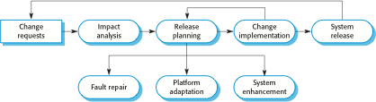
The software evolution process

Slide 105
Urgent change requests
Urgent changes may have to be implemented without going through all stages of the software engineering process
If a serious system fault has to be repaired to allow normal operation to continue;
If changes to the system’s environment (e.g. an OS upgrade) have unexpected effects;
If there are business changes that require a very rapid response (e.g. the release of a competing product).

Slide 106
Software maintenance
Modifying a program after it has been put into use.
The term is mostly used for changing custom software. Generic software products are said to evolve to create new versions.
Maintenance does not normally involve major changes to the system’s architecture.
Changes are implemented by modifying existing components and adding new components to the system.

Slide 107
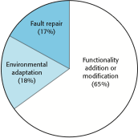
Maintenance effort distribution

Slide 108
System re-engineering
Re-structuring or re-writing part or all of a legacy system without changing its functionality.
Applicable where some but not all sub-systems of a larger system require frequent maintenance.
Re-engineering involves adding effort to make them easier to maintain. The system may be re-structured and re-documented.

Slide 109
END OF CHAPTER 1

